Slide 1

ALAGAPPA UNIVERSITY
State University | A++ Grade by NAAC(GCPA:3.59)in the 4th Cycle in dual mode | Category-I
University by MHRD-UGC
Karaikudi-630 003,Tamil Nadu, India
Inter/Intra Institutional Start-up Competition and Deposition in the Institution’s YUKTI-Innovation Repository
Department of Computer Applications
Co-ordinator: Dr.A. Nagarajan, MCA ., M.Phil ., Ph.D..,

Slide 2
ANIMAL BEHAVIOUR MONITORING SYSTEM USING IOT
Under the guidance of
Dr.P. Eswaran, M.Sc., M.Tech., Ph.D ..,
Assistant Professor
Team Name: Tech Spartans
Presenter’s Name: SOMU R , MANI BHARATHI G , VETRI VEL ,SUJEETH NICOLES , JEYAVELAN

Slide 3
ABSTRACT
Animal behavior monitoring is an emerging interdisciplinary research area with significant applications in wildlife conservation, livestock management, precision farming, and ecological studies.
Traditional observation-based techniques are time-consuming, invasive, and subject to human error, making them insufficient for large-scale or real-time behavioral analysis.
Recent advances in Internet of Things (IoT) have enabled the development of intelligent, automated systems that can track, analyze, and interpret animal behavior with higher accuracy and scalability.
The research highlights potential challenges such as energy efficiency in IoT devices, data privacy, network scalability, and ethical concerns regarding invasive monitoring.

Slide 4
PROBLEM STATEMENT
Monitoring animal behavior is essential for understanding health, welfare, and ecological impact. However, traditional observation methods are manual, time-consuming, and prone to human error, making it difficult to continuously monitor animals in natural habitats or farm environments.
There is a need for an automated, accurate, and real-time animal behavior monitoring system that can track movements, detect behavioral changes, and generate reliable insights for research, conservation, and management purposes.
Animals are tracked using collars that frequently record their locations, enabling researchers to observe both behavior and environmental interactions.
Collars serve as the primary data collection interface, gathering information from sensors. They also monitor the animals' posture, behavior, and location.

Slide 5
EXISTING SYSTEM
Animal behavior monitoring has been practiced for many years across different fields. In the early stages, the field was dominated by biologists and zoologists, who relied on manual observation and note-taking to study wildlife behavior.
Later, wildlife organizations and conservationists adopted technologies such as camera traps, GPS collars, and radio tracking to monitor endangered animals in forests and sanctuaries.
At present, animal behavior monitoring is being practiced in multiple domains. In wildlife studies, researchers depend on camera traps, drones, and GPS collars to record the movements and activities of animals in their natural habitats.

Slide 6
PROPOSED SYSTEM
Instead of relying only on manual observation or simple tracking devices, the system integrates IoT sensors to continuously monitor animals with minimal human effort.
Data collected from sensors (e.g., temperature, motion, GPS) is transmitted through IoT networks to a centralized platform, where it is analyzed in real-time. The system can generate alerts in case of unusual behavior, diseases, or movement anomalies, ensuring quick response for both wildlife conservation and livestock management.
It can be applied in multiple domains such as wildlife monitoring, smart farming, ecological research, and animal welfare management. Overall, this system ensures continuous, reliable, and intelligent monitoring that supports decision-making, improves animal health and welfare, and contributes to biodiversity conservation.

Slide 7
HARDWARE COMPONENTS
ESP32-CAM (main MCU, Wi‑Fi, camera)
Mic (MAX4466/INMP441) – sound RMS for distress/noise
PIR (HC-SR501) – motion detection
DHT11/DHT22 – temperature/humidity
Power: 5V/2A with stable regulator

Slide 8
SOFTWARE COMPONENTS
ESP32 firmware: HTTP POST JSON, basic filtering/debounce
PHP APIs on XAMPP: insert/get/history endpoints
MySQL schema: readings(ts,temp,pir,sound_rms,image_url)
Android app: Retrofit, charts, camera stream view

Slide 9
ADVANTAGES
It enables accurate and continuous data collection, reducing human errors that occur with manual observation.
With the help of IoT, animals can be monitored in real time, allowing early detection of unusual behavior, stress, or diseases, which directly improves their health and welfare.
In wildlife, such systems support conservation efforts by tracking migration, habitat use, and protecting endangered species.
It reduces human effort, making monitoring less labor-intensive while still generating reliable results.
Additionally, monitoring systems can play a vital role in preventing human–animal conflicts by predicting animal movements near populated areas.
Overall, animal behavior monitoring provides better decision-making support, ensures sustainability, and creates valuable datasets for future research and technological development.

Slide 10
SYSTEM ARCHITECTURE
XAMPP / PHP APIs
MySQL DB
Android App
• Live Cam
• Charts
• Alerts
ESP32-CAM
Mic • PIR • DHT • GPS

Slide 11
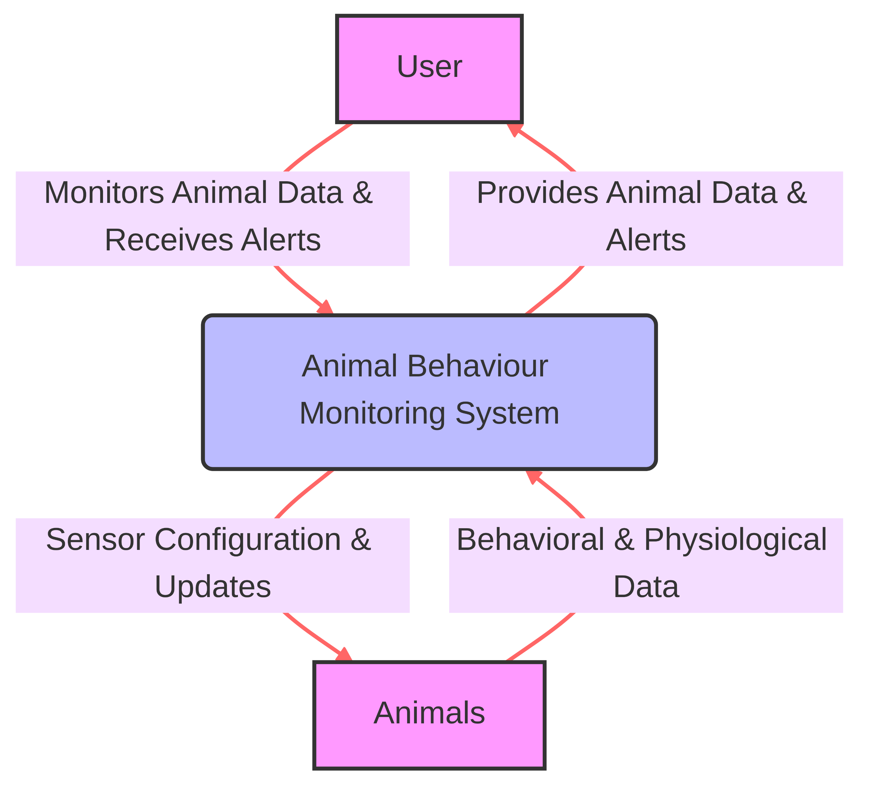
DATA FLOW DIAGRAM
Level 0

Slide 12
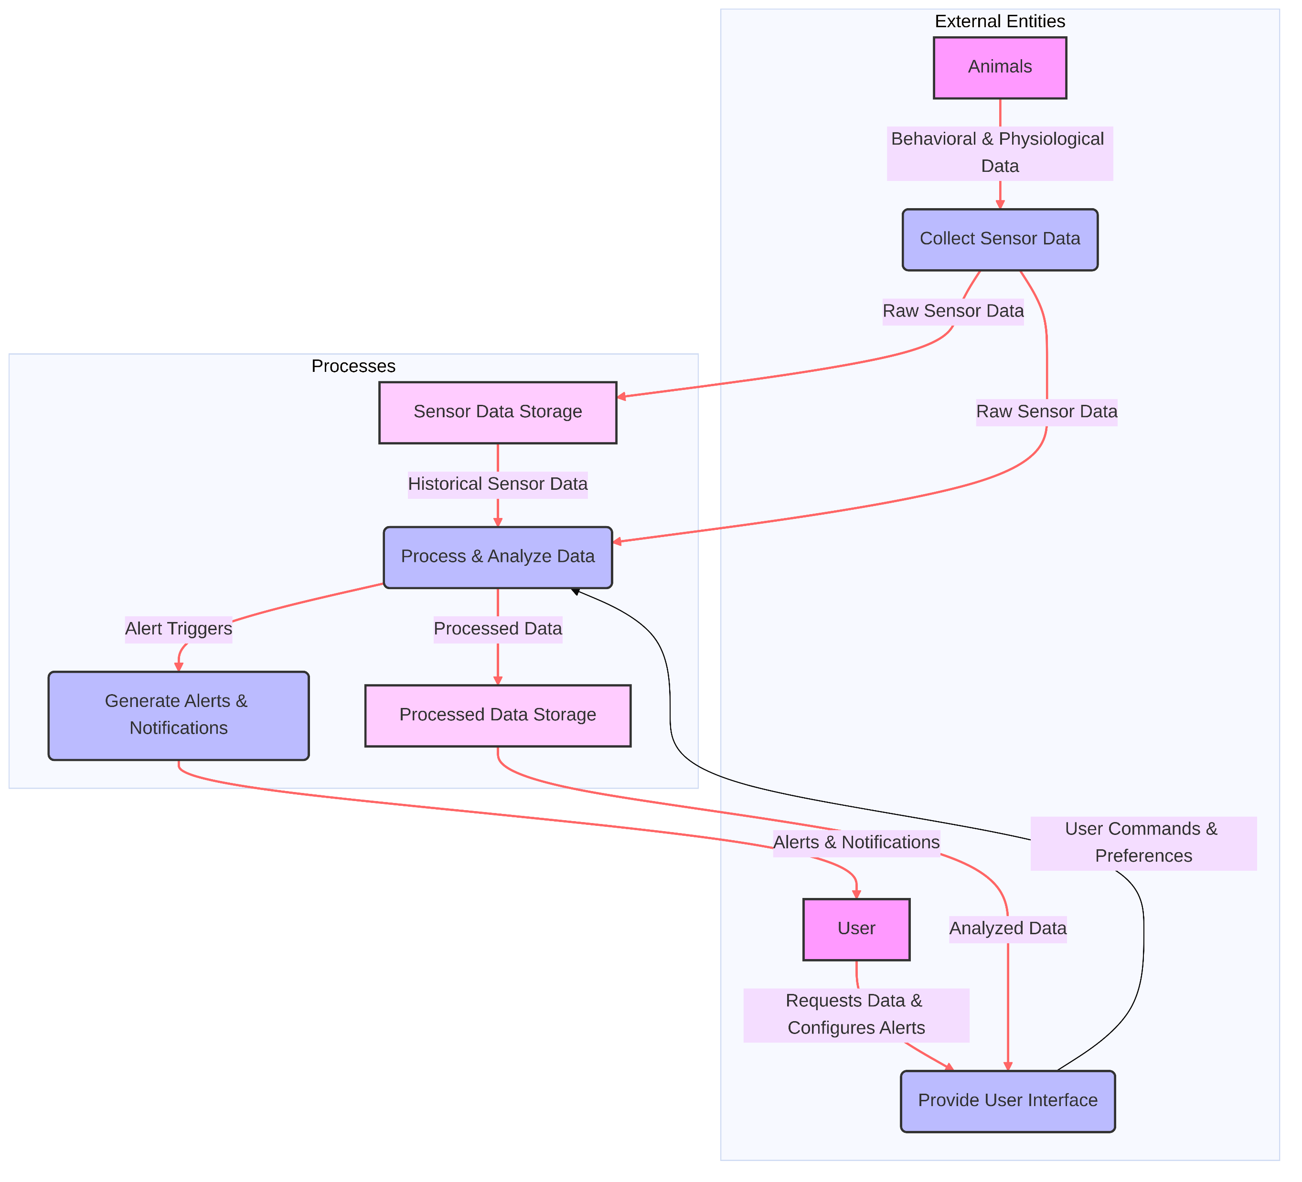
DATA FLOW DIAGRAM
Level 1

Slide 13
CONCLUSION
By integrating sensors, wearable devices, cameras, and applications, IoT systems enable real-time tracking, accurate data collection, and early detection of abnormal behavior. This not only helps in improving animal welfare and farm productivity but also plays a crucial role in wildlife conservation, ecological research, and conflict management. With the support of IoT, large-scale monitoring becomes possible, reducing human effort while increasing reliability and scalability.
Although challenges such as cost, connectivity, and data management remain, they can be mitigated with advancements in low-power devices, edge computing, and secure communication.
Overall, IoT-based animal behavior monitoring ensures a sustainable, data-driven, and smart approach that benefits farmers, researchers, conservationists, and society at large

